Slide 1
VIRGINIA SWIMMING
Swimposium
SEPTEMBER 30, 2017

Slide 2
REFEREE – MEET & DECK agenda
Introductions
MANAGING THE MEET - Teamwork & leadership
TRAINING
TEAM
PREPARATION
National deck
questions
Notes:
Get acquainted
Interactive/don’t let the presentation hold you back
Talk about philosophy and approach as much as details
Specific questions that you sent to me form the points of the presentation as well as Q & A at the end

Slide 3
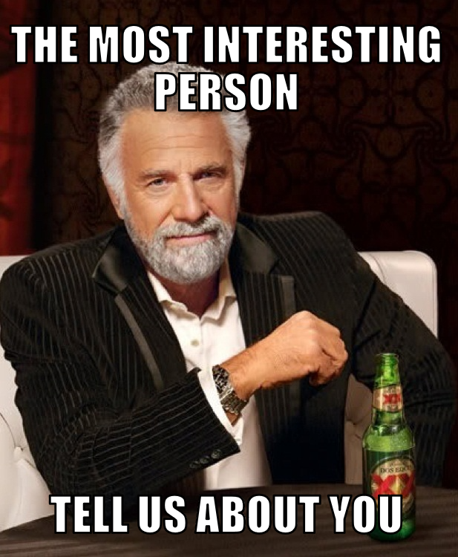
INTRODUCTIONS
Officiating – how long?
Why?
What levels – S & T, Referee, etc? LSC, N2, N3?
Why are you here?
Notes:
* OK it’s the old guy! I think he is now on Mars.
How long have you been officiating? Why? What levels – S & T, Referee, etc & LSC, N2 or N3?
As we go I’ll be interested in your perspectives too.

Slide 4
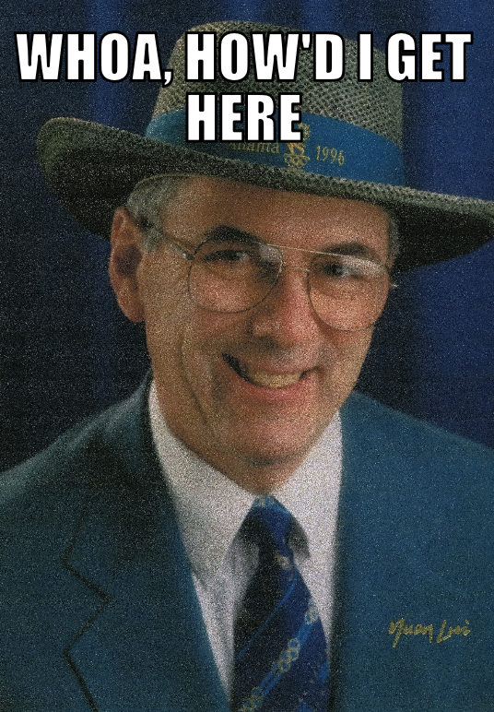
background
Officiating:
1981 – summer league
1988 – us open
1992 – trials (+6)
1996 – fina list (Pool & open water)
1996 & 2000 Olympics
2000 trials referee
Multiple world championships & wugs
Ncaa – pac-12 referee; div. 1 referee/starter
Other
Notes:
USA Swimming:
Officiating 1981
VP Program Operations 1998
President 2002 – 2006
BOD 1998 – Present
USA Swimming Foundation 2004 – Present
USSIC BOD & Treasurer 2002 – 2014
USOC BOD & NGBC 2002 – present
Committees & task forces
Officials:
Why have I stayed engaged for so long?
Learn from other officials
Learn from other cultures
Give back
General:
Welcoming organization
Embrace the culture and the sport
Positive contribution
Share experience
Encourage participation and change (diversity, gender equity, various roles and responsibilities)
Management skills development – Outward bound story
FUN & FRIENDS

Slide 5
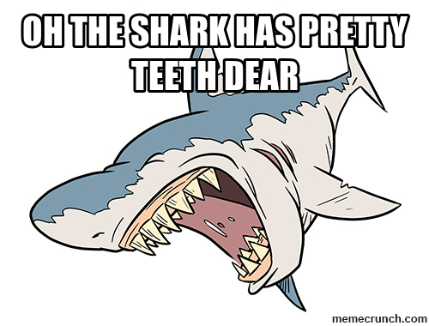
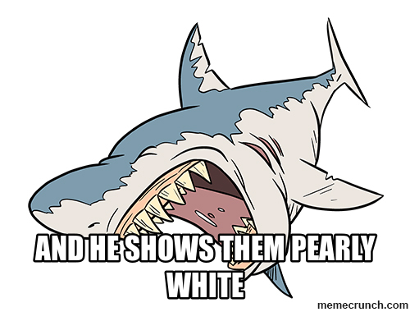
MANAGING THE MEET
Notes:
Have some fun!
Remember “Mack The Knife” (Bobby Daren, Frank Sinatra, Elvis) From the “Three Penny Opera”
PHILOSOPHY:
Being a leader (referee) is like a “Three Penny Opera” and as we know there are sharks out there and they do have teeth.
Talk about three elements of being a leader – especially being a referee.
Easy to talk about the lists of things to do that are on the USA Swimming website, personal lists, etc. but its how you handle the leadership that is vital.

Slide 6
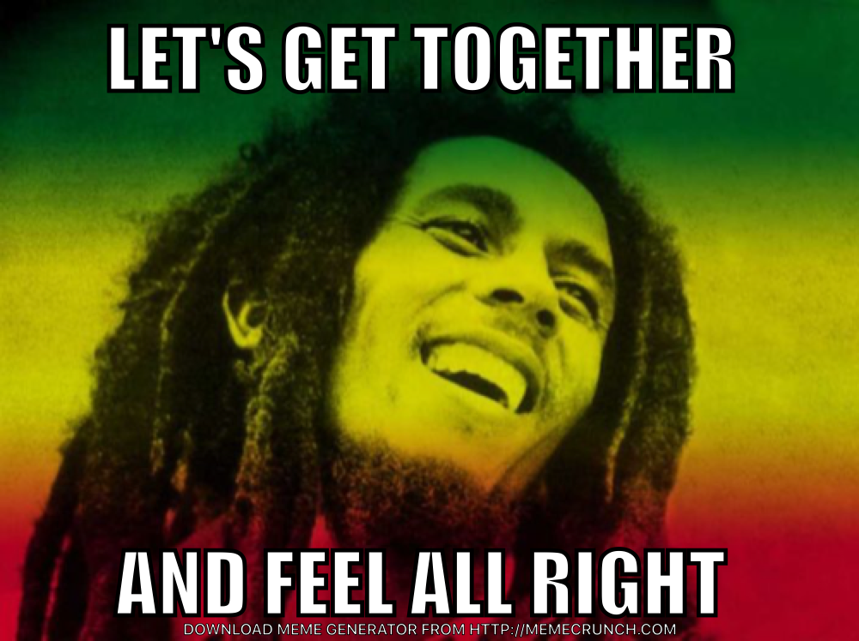
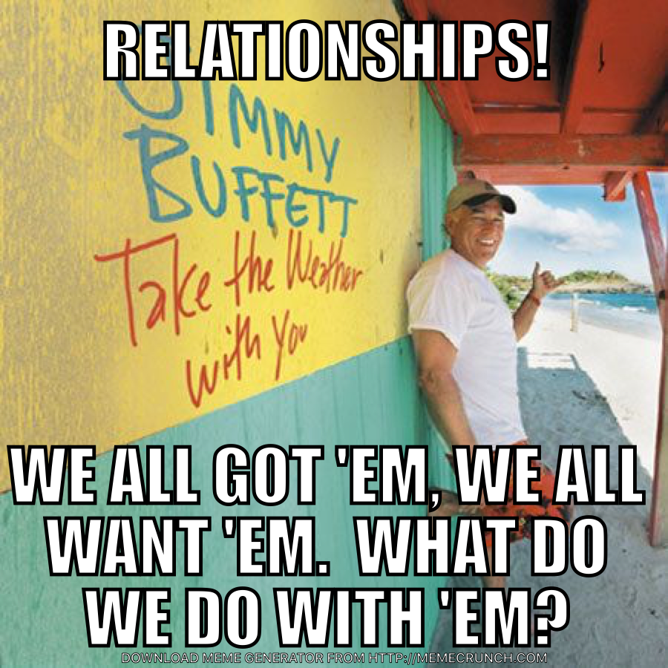
Leadership elements
Notes:
OK – some of my favorites – Marley, Buffett and the Animals
Three elements:
The Team – It’s your group, you’re the leader
“Let's get together and feel all right.” – Bob Marley
Relationships
Establish and manage relationships in the team
“Relationships! We all got 'em, we all want 'em. What do we do with 'em?” - Jimmy Buffett
Communications
Goes both ways
Folks want to know what is expected and how they are doing
“Yes, I'm just a soul whose intentions are good Oh Lord, please don't let me be misunderstood” – The Animals
Many books written on leadership but these three came from some personal experiences that we’ll talk about next.

Slide 7
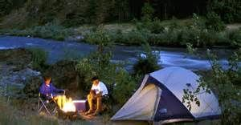
BACKGROUND
Notes:
Outward-bound (Anybody heard about Outward-bound?
Team-building
Diversity
Experience
Management styles
Self-evaluation
Team-building
Relationships
Communication
Outcomes
Back at work

Slide 8
MEET MANAGEMENT – THE TEAM
Notes:
Delegator vs micro-manager (Does it make any difference?)
Set the tone
Team-builder
Communicator
Team
Coaches
Athletes
Build confidence
Team
Coaches
Establish credibility

Slide 9
Meet management - RELATIONSHIPS
Notes:
Meet management
Officials
Coaches
Athletes
Comments:
All part of the team
Success depends on strong relationships among all parts of the team

Slide 10
Meet management - COMMUNICATIONS
Notes:
Before the meet
Meet information
Meet management
Officials (especially the leadership team)
Before competition
Technical meeting
Officials meeting
During the meet
Coaches
Officials

Slide 11
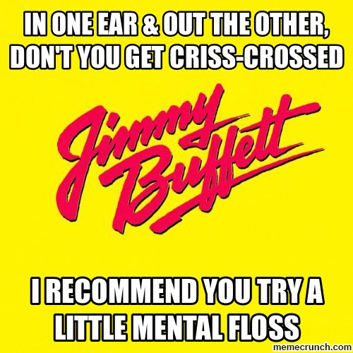
SUMMARY
Notes:
Teamwork
Balance
Relationships
Confidence
Communications
Expectations
How’d we do?
Team work - Did we get together and feel all right?
Relationships – Did we get ‘em? What did we do with them?
Communications - Were we understood?
SUMMARIZE

Slide 12
Referee training
Experience, experience, experience!!!
S & t, CJ, starter, referee, administrative referee, meet director
All levels of meets
Mental check lists
Before the meet
Before the session
Before each event
Before each race
After each event/session
Traits of a good referee
Notes:
Experience
Always learn from each meet (smallest to largest)
Learn from your mistakes and assumptions
Work each of the positions
Work all levels and approach is different
CJ’s or not
# starters and deck referees
Team leads?
# of S & T
Levels of officials (LSC/N2 >>>> Trials)
Mental Checklists
Where I sit during a meet
Anticipate
Not micro-manage
Before the Meet (QUESTION) – Meet announcement, develop the team, communicate, assignments, technical meeting (notes & issues), meet management & facilities
Before the session (QUESTION) – Assignments, equipment, marshalls, paperwork, walk the deck
Before the event (QUESTION) – Deck set (flags), timers, paperwork, timeline
Before Each Race (QUESTION) – Issues, DQ’s, communications
After each race/session (QUESTION) – Issues, team, walk the deck, paperwork, meet management/facilities
Traits of a good referee (QUESTION)
Leader (team, relationships, communications)
Patience
Humble (not God)
Learn
Seek & accept feedback

Slide 13
TEAM
Cj, starter, deck referee & Admin Referee– all leaders
Chief judge – “assistant & mentor to all officials”
Starter – “it’s more than three short words”
Deck Referee – “it’s more than blowing the whistle”
Administrative referee – “It’s more like service with a smile”
Meet director
Notes:
USA Swimming – “Professional ……”
CJ – Toughest job on deck
Team-lead
Work with all the other officials (S&T >> Admin >> meet management)
Starter
“Direct contact” w/athletes
Team w/deck ref
USA Swimming protocol vs international protocol
Not everyone a starter & can’t always start
Deck Referee
On-deck leader
Team with starter, CJ’s, meet referee
Administrative Referee – Keep track of the details, team w/meet referee (story of start of Adm. Ref)
Meet Director – Facilities, equipment, hospitality, security

Slide 14
preparation
Level of meet
Number & level of officials
Pre-meet
Pre-competition
Competition
Post-competition
Resources
Usa swimming website
http://www.hostgreatmeets.com/
Notes:
Talked about preparation before
Repeat & summarize – Pre-meet, Pre-competition, Competition, Post-competition
Level of meet,
Officials
Resources

Slide 15
National & international deck
Roles
Chief judge
Starter
Referee
Administrative referee
what CAN WE LEARN?
Notes:
Roles
More defined
More experienced (Maybe less on international deck)
Some different terms and jurisdiction (We in the US don’t always do it perfect.)
Motivation may be different
Chief Judge
Nationals – more CJ’s, sub-sets of responsibilities, more communication and preparation
International – “Chief Inspector of Turns”; stroke – TSC (Explain TSC)
Starter
Nationals – Professional Starter – voice, timing, teamwork, procedures
International – Much more variation (2012 Olympics); DR/Str responsibilities & timing; May be the only thing they do
Deck Referee
Professional referee
Situations more emotional & sophisticated
More impactful (Quance)
Under-water cameras (USA)
Administrative Referee
Tighter policies
Resolution deck (swim-off, seeding, check-in)
Omega & cameras – timing & RTO

Slide 16
questions
What are your experiences as a MR at different levels of competition – LSC, Zone, National & International?
How do you prepare? Checklists?
Selecting your leadership team – which positions are key & what are your requirements?
Notes:
Experiences
Lower to higher levels – more experience, more defined, higher impact more formal
LSC – training officials & coaches (summer league)
Zone – more mentoring, first time at level, mix of experience
National – less mentoring & more formal assignments, emphasize leadership skills (Dallas/Lowes Pool; Nashville; Olympic Trials)
International – Different – TSC; Strict (World Juniors “Do you have a call”
How Prepare
Level of Meet
Read (Meet Info, Rulebook, Professional)
Experience of officials
Put all else aside
Select the Leadership team
Level of meet
Talent available
Strong leaders at CJ T/L, Head Starter, DR
Form a team,
Relationships
Communicate
Recommendations from National Officials Committee, Zones & LSC’s

Slide 17
questions
Meet issues –
Sick swimmer, injury which allows them to miss finals?
Delay-of-meet vs no-show
Tips to working with coaches on deck during the meets
Notes:
Sick Swimmer/ Injury
Know ahead of time – reseed w/alternate (Contact information)
Before scoring heat – put alternate in (no reseed) (Example – Husky Invite heats in finals)
Technical meeting
Delay-of-meet vs No Show
Depends on meet information (Check-in vs scratch & penalties)
Preliminaries – may be out of rest of day & positive check-in or no penalty
Finals – probably out of meet (Note if scratched in – no penalty)
Coaches
Been called a “cheat” & a “liar”; Also “More comfortable you here” Olympics & “Honorable and best in the business”
Sooo –
Athlete first
Not the enemy
Patience
Calm
Listen
They are advocating
Equitable
Walk the deck
Proactive
Create a relationship
Don’t hold a grudge

Slide 18
Questions & discussion

